Slide 1
Spectroscopy

Slide 2
Spectra means radiations and Scopy means study.
Spectroscopy is the study of the interaction between electromagnetic radiation and matter.
The matter may be atoms, molecules or ions.

Slide 3





Interaction of electromagnetic radiation
With matter

Slide 4
Significance of the study of Spectroscopy
Used in Astronomy to find the availability of minerals, water etc.
Used in Large spectroscopes which are used to find out the chemical compositions and physical properties of Astronomical objects
In medical field (ECG, X -Ray, MRI etc.)
Used in the quantitative and qualitative analysis of chemical substances.

Slide 5
Advantages of the spectroscopic Techniques
Less time is required.
The measurement is very accurate.
Requires very small amount of the sample.
After recording the spectra ,the sample can be reused.

Slide 6
Spectrometer
Spectrometer is an instrument which can be used to measure the presence of particular compound or particle in a molecule.

Slide 7
Spectrum
Spectrum is a plot of the amount of light absorbed by a sample versus the wavelength of the light.
The amount of light absorbed is called the absorbance.

Slide 8
Electromagnetic radiation
An electromagnetic radiation is a radiant energy emitted from any source in the form of light, heat or sound.

Slide 9
Characteristics of Electromagnetic Radiation
Electromagnetic radiation possess particle nature as well as wave nature. A light beam consists of stream of particles (photons) moving in the form of waves.
2. Electromagnetic radiations travel with the velocity of light.i.e.2.998x10⁸
3. The electromagnetic waves have electric and magnetic fields associated with them at right angles to one another. If the radiation is moving along the X axis, the magnetic field is oriented along the Y axis and electric field is oriented along the Z axis.
³

Slide 10
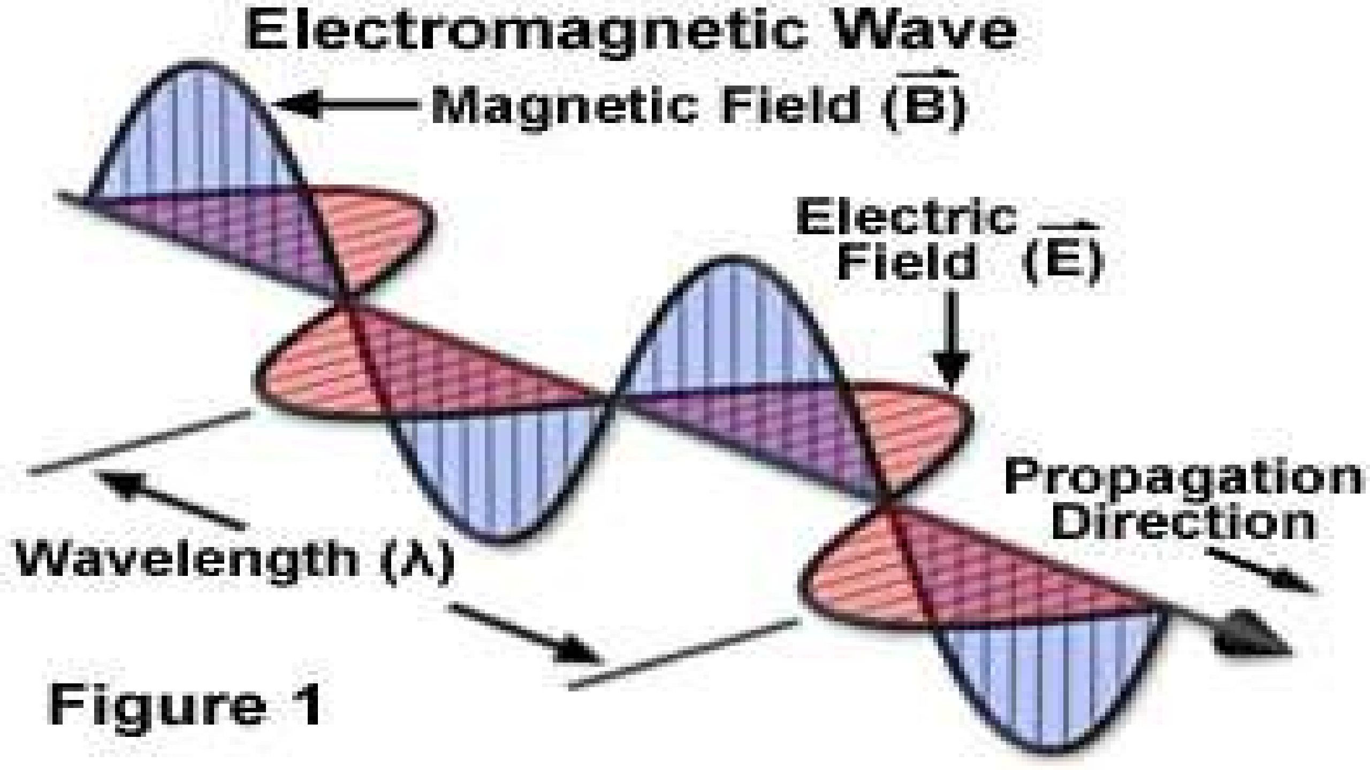

Slide 11
Electomagnetic spectrum
The whole range of frequencies/wavelength of the electromagnetic radiations arranged in an order is known as Electromagnetic spectrum.
Radio waves
Microwaves
Infrared rays
Visible light
Ultraviolet light
X-Rays
Gamma Rays

Slide 12
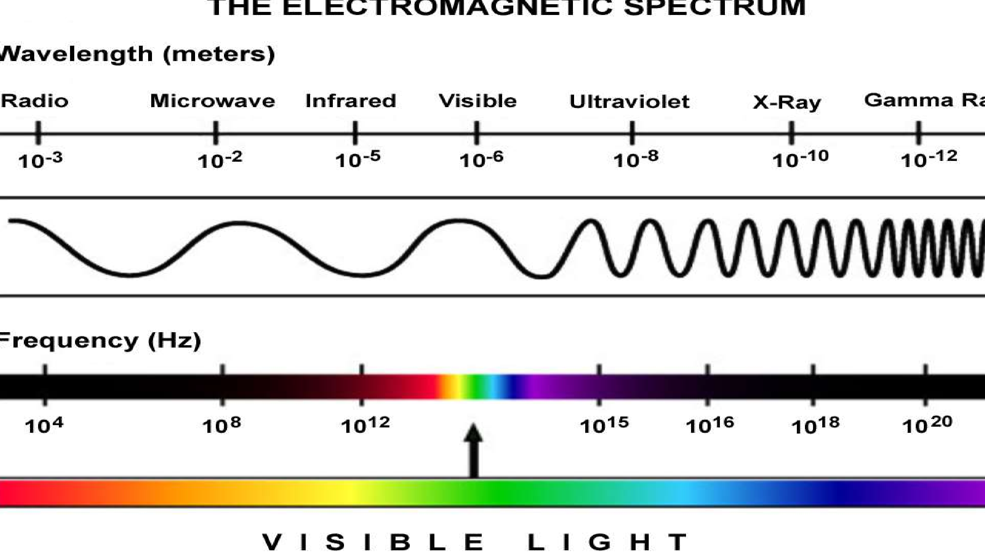

Slide 13
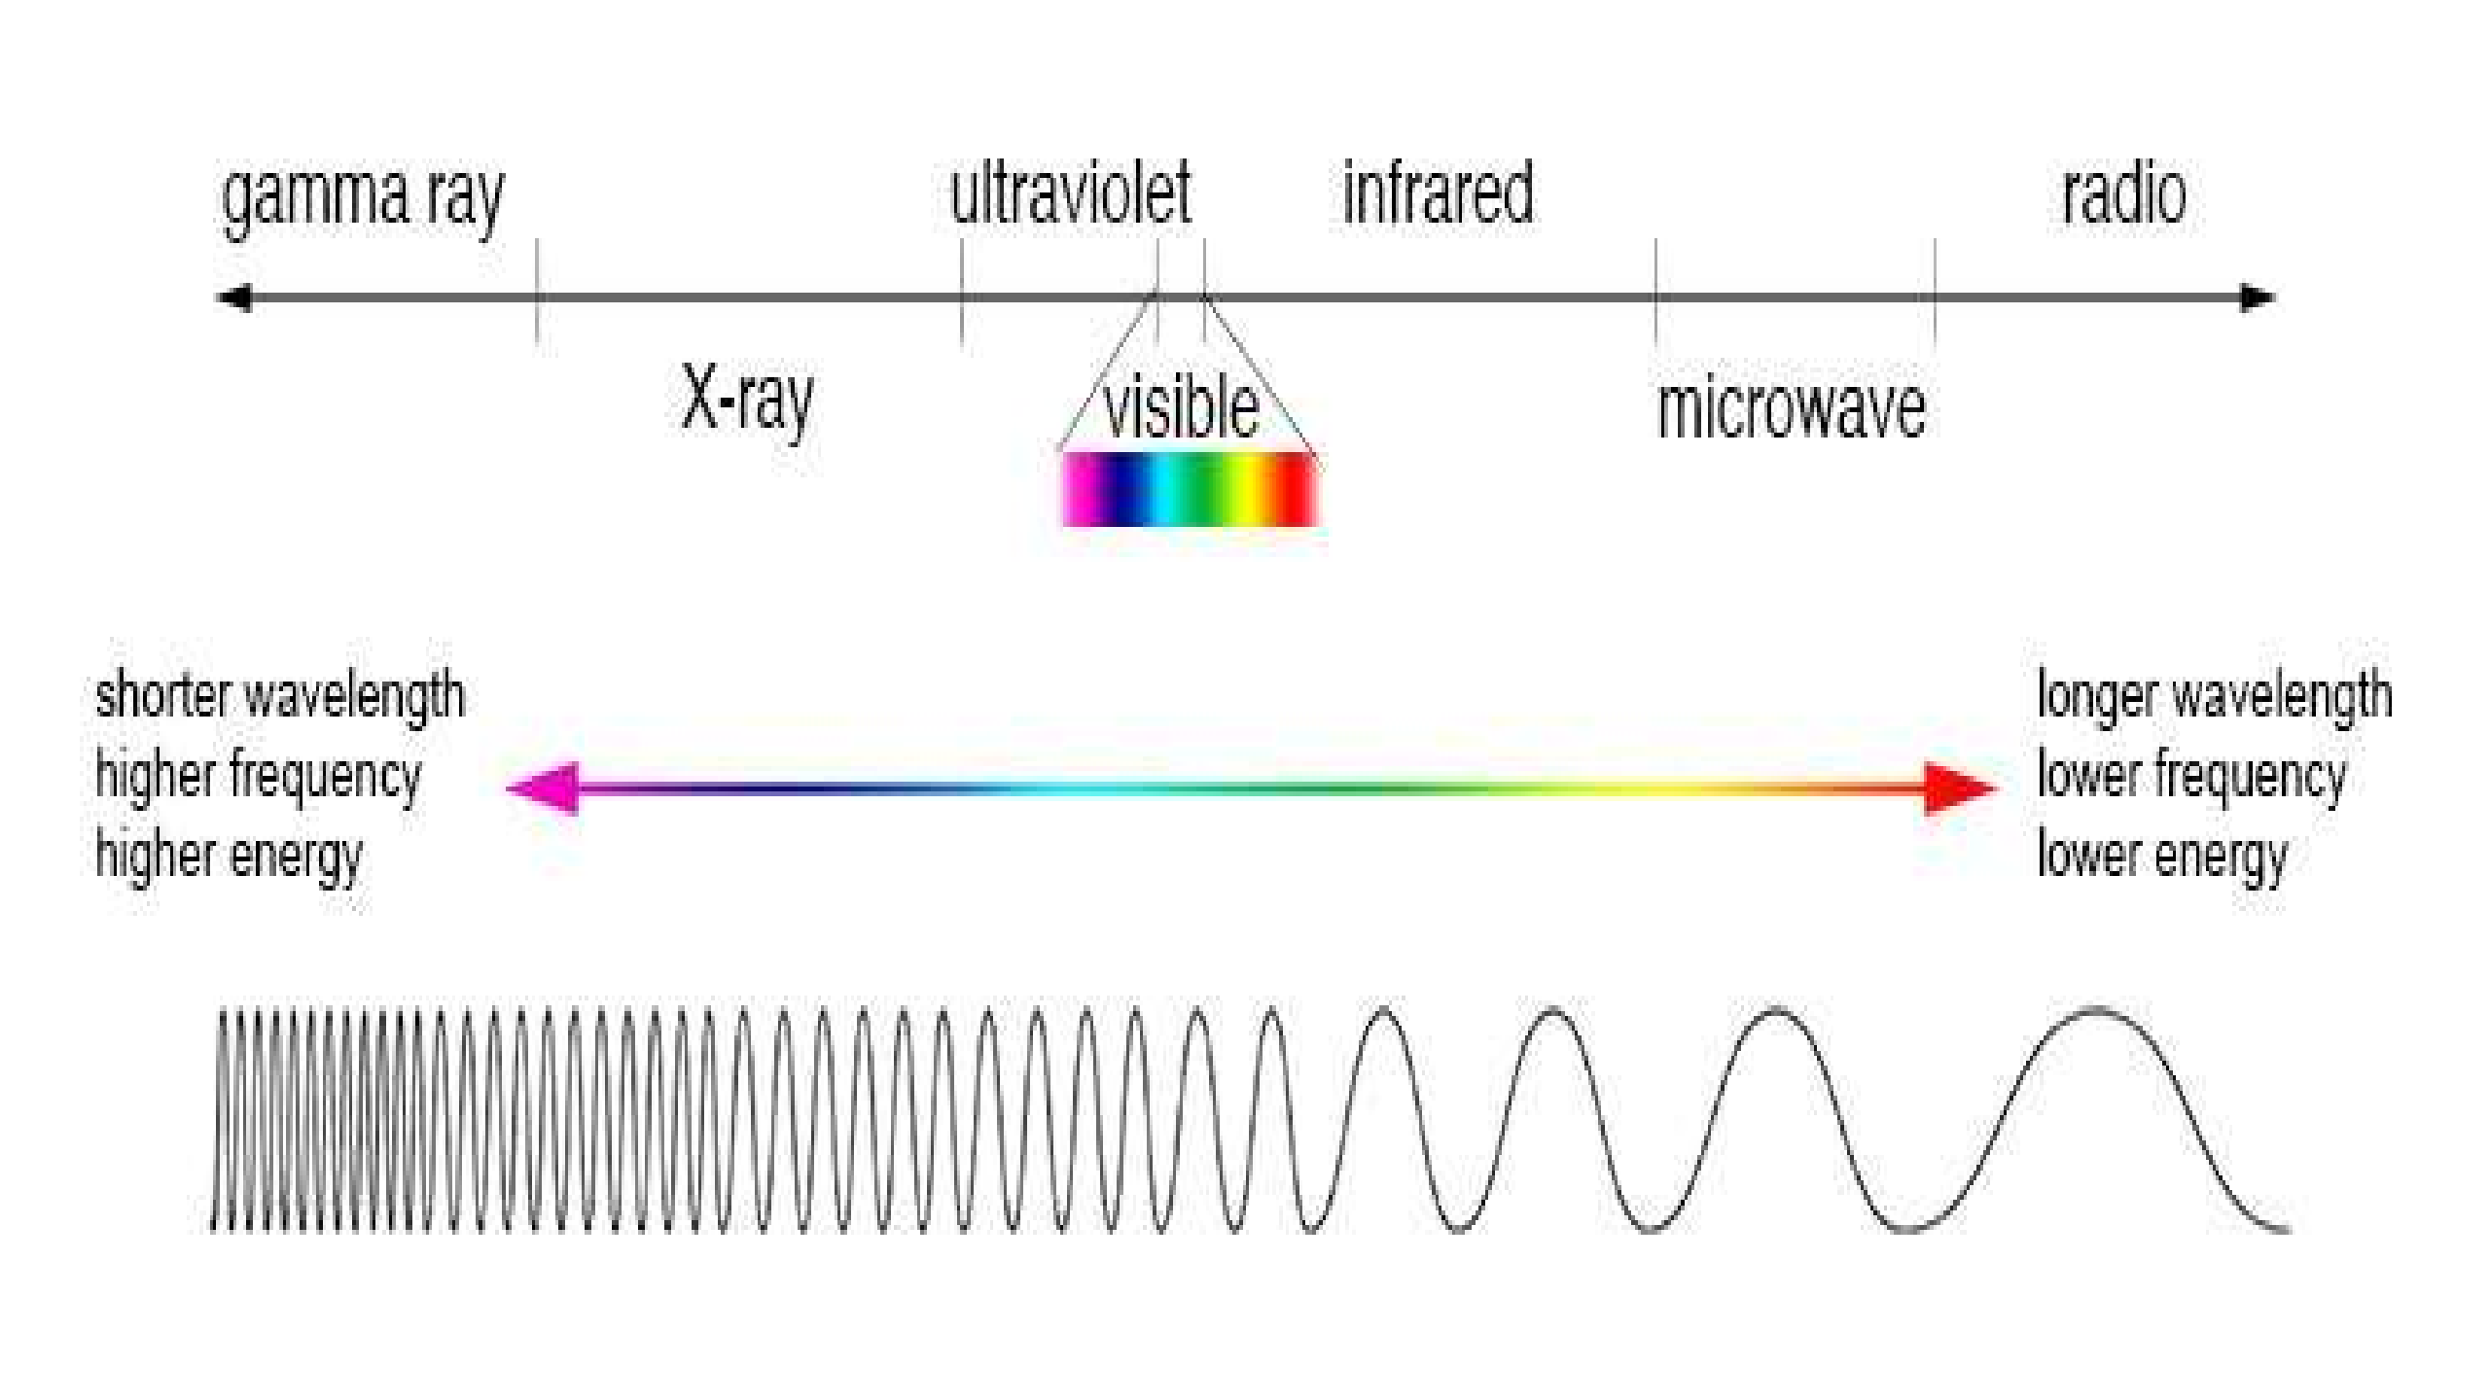

Slide 14
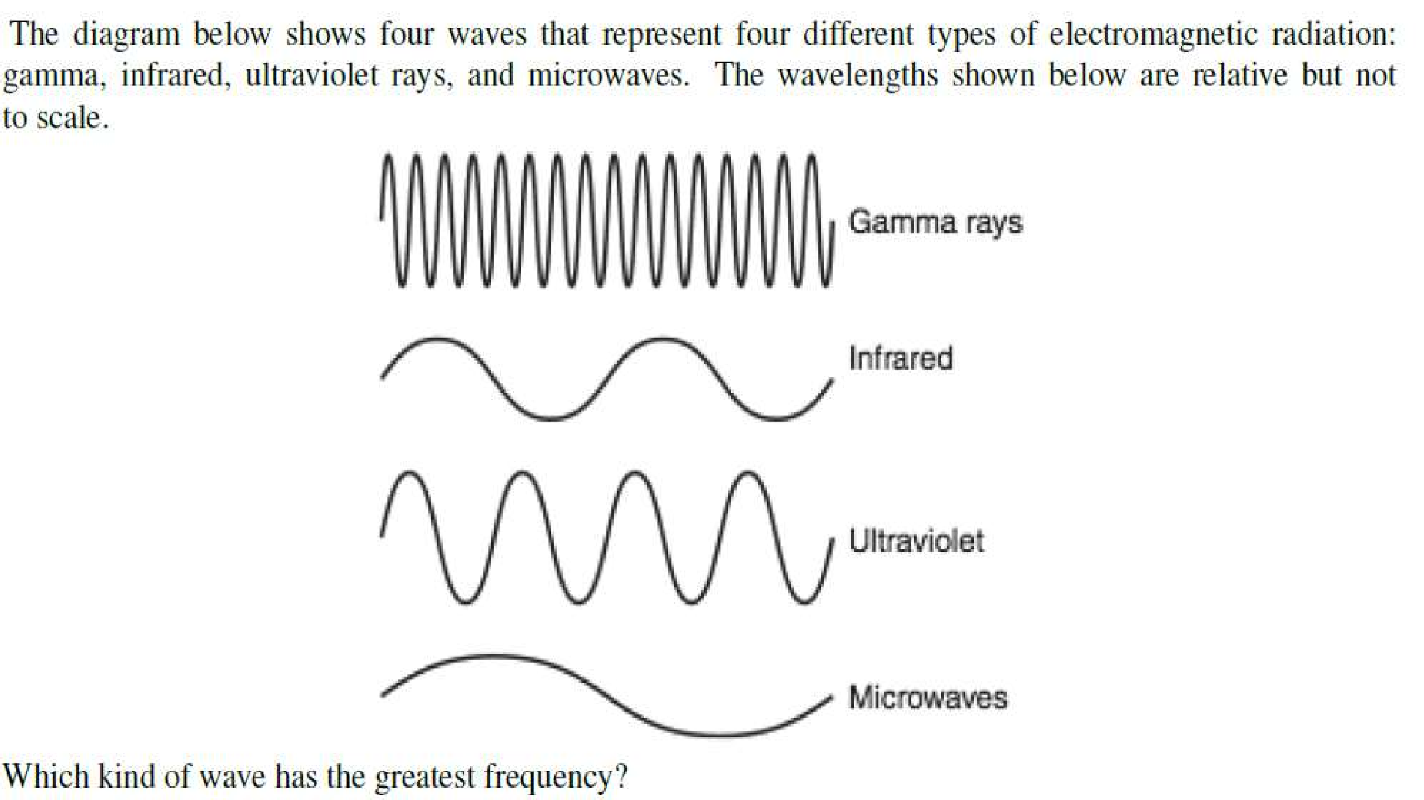

Slide 15
Electromagnetic spectrum
Electromagnetic spectrum ranges from very short wavelength (gamma rays) to very long wavelengths(radio waves).
The visible region of the spectrum extends approximately over the wavelength range 400-700nm.
The shorter wavelength being the blue end of the spectrum and the longer wavelength the red.

Slide 16
Electromagnetic spectrum
The wavelength between 400 and 200nm make up the near ultraviolet region of the spectrum.
The wavelength above 700nm to approximately 2000nm the ultraviolet region.

Slide 17
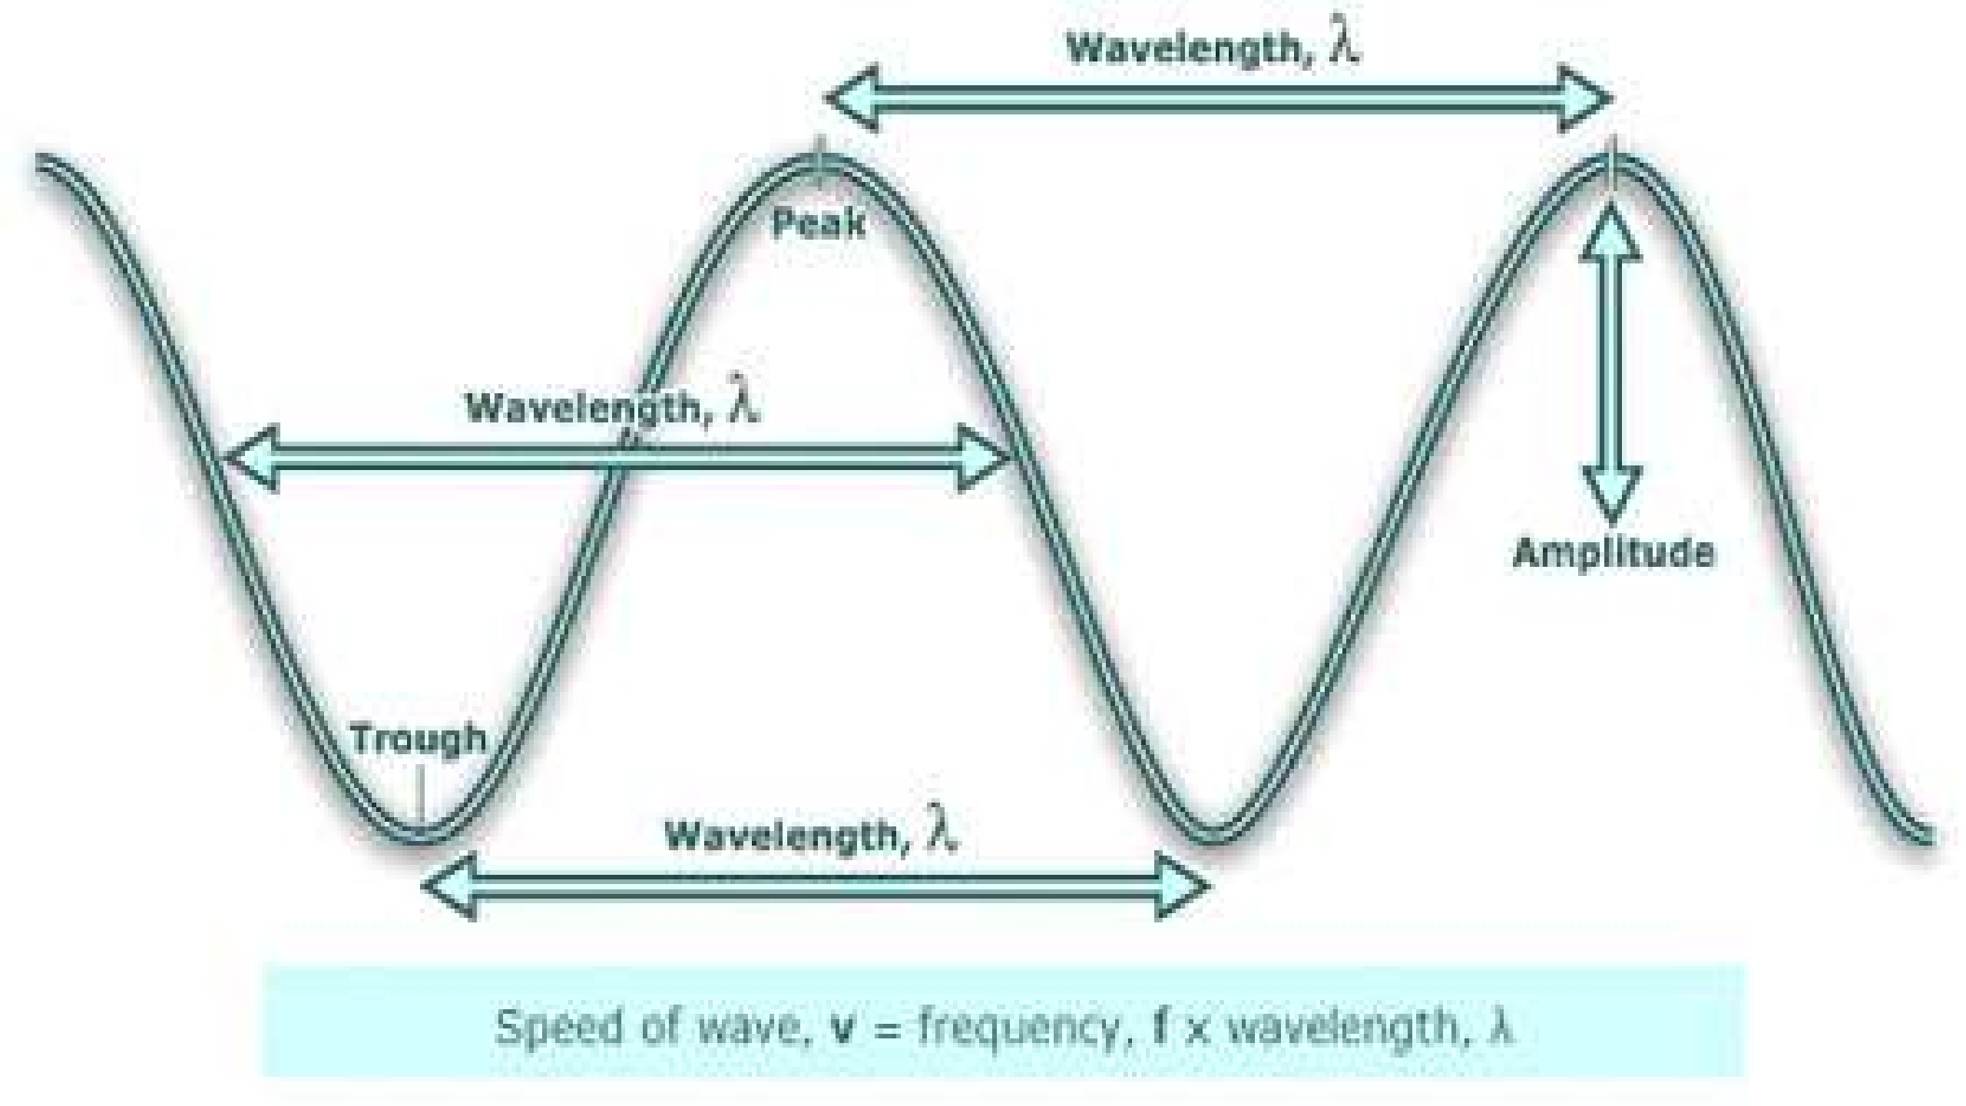

Slide 18
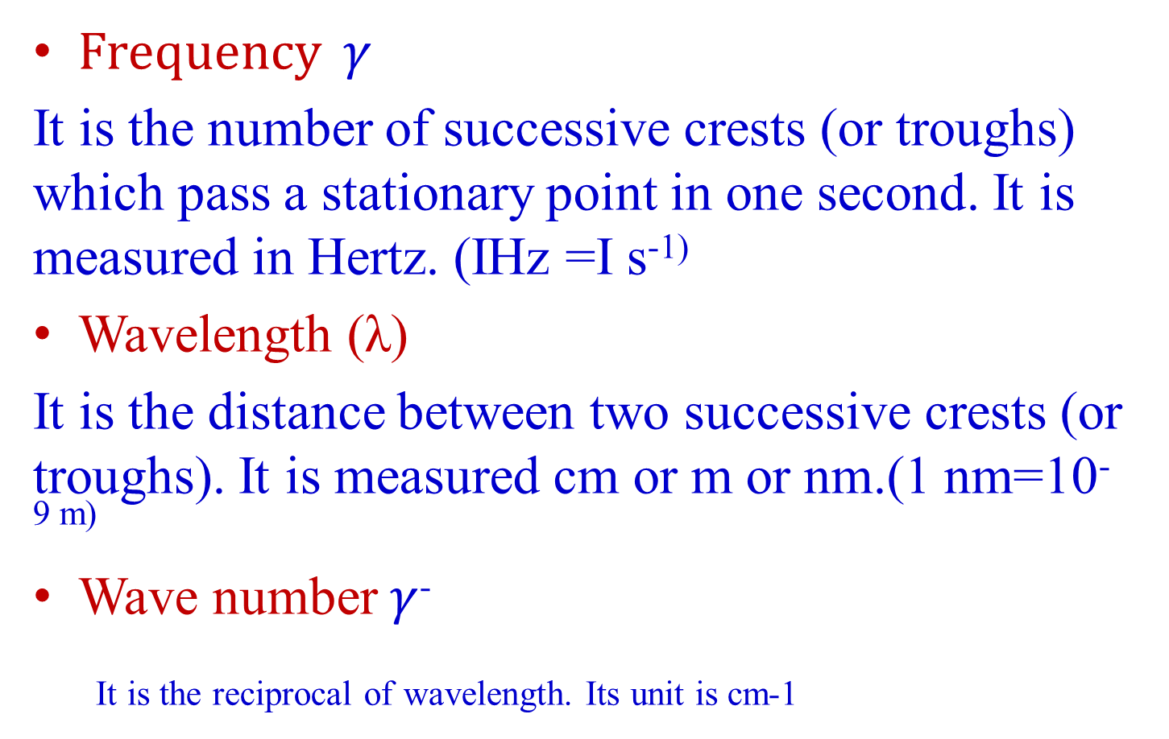
Various terms...
Frequency $γ$
It is the number of successive crests (or troughs) which pass a stationary point in one second. It is measured in Hertz. (IHz =I s⁻¹⁾
Wavelength (λ)
It is the distance between two successive crests (or troughs). It is measured cm or m or nm.(1 nm=10^{-9 m)}
Wave number $γ$⁻
It is the reciprocal of wavelength. Its unit is cm-1

Slide 19
Rotational ,Vibrational and Electronic Energies of Molecules
Rotational Energy
It involves the rotation of the molecules or part of the molecules about the centre of gravity.
Vibrational Energy
It is associated with stretching, contracting or bending of covalent bonds in molecules. The bond behave as spirals made of wire.
Electronic Energy
It involves changes in the distribution of electrons by splitting of bonds or the promotion of electrons into higher energy.

Slide 20
The nature of the interaction between radiation and matter may include-
Absorption
Emission
Scattering
They help in the study of matter with respect to
Qualitative study
Quantitative study

Slide 21
Interaction with matter...
The effect of electromagnetic radiation on interaction with matter depends on energy associated with the radiation.
Very energetic radiations (UV and X-ray) may cause an electron to be ejected from the molecules.
Radiation in the infrared region of the spectrum have much less energy they can cause vibrations in molecules.

Slide 22
Interaction with matter...
Microwave radiation is even less energetic than infrared radiation it can neither induce electronic transition in molecules nor can it cause vibrations it can only cause molecules to rotate.
Ultraviolet, visible - electronic transitions
Infrared - molecular vibrations
Microwave - molecular rotation

Slide 23
Types of spectroscopy
When radiation meets matter, the radiation is either scattered, emitted or absorbed. So there are of three types of spectroscopy.
Absorption spectroscopy
Scattering spectroscopy
Emission spectroscopy

Slide 24
Absorption spectroscopy
In absorption spectroscopy an electromagnetic radiation is absorbed by an atom or molecule
Which undergoes transition from a lower energy state to a higher energy or excited state.
Absorption occurs only when the energy of radiation matches the difference in energy between two energy levels.

Slide 25
Scattering spectroscopy
Scattering spectroscopy measures certain physical properties by measuring the amount of light that a substance scatters at certain wavelengths .
One of the most useful applications of light scattering spectroscopy is RAMAN SPECTROSCOPY.

Slide 26
Emission spectroscopy
Atoms or molecules that are excited to high energy levels can decay to lower levels by emitting radiation.
The substance first absorbs energy and then emits this energy as light.
Emission can be induced by sources of energy such as flame or electromagnetic radiation.

Slide 27
Atomic Spectroscopy Vs Molecular Spectroscopy
Atomic Spectroscopy
In the case of atoms, electrons jump from a lower orbit to a higher orbit. When they start coming back to the lower orbit, emission of energy equal to the difference in the energies of the two orbitals takes place in the form of atomic spectrum.

Slide 28
Molecular Spectroscopy
In the case of molecules, when the energy is absorbed,it may result into rotation, vibration or electronic transition depending upon the amount of energy absorbed.
The rotational ,vibrational and the electronic energy levels of the molecule are collectively called as Molecular Energy Levels.
The transition of energis taking place between these energy levels result in Molecular Spectra.

Slide 29
Principles of absorption spectroscopy
A = - log (T)
Absorption of light by a sample

Slide 31
Principles of absorption spectroscopy
Lamberts law:
It states that when monochromatic light passes through a transparent medium, the intensity of transmitted light decreases exponentially as the thickness of absorbing material increases.
Beer’s law:
It stats that the intensity of transmitted monochromatic light decreases exponentially as the concentration of the absorbing substance increases.

Slide 32
Beer-lamberts law
The Beer-Lambert law states that the amount of light absorbed by a substance dissolved in a fully transmitting solvent is directly proportional to the concentration of the substance and the path length.
A = a x b x c
where
a = the absorptivity of the substance
b = path length
c = concentration of the substance
When working in concentration units of molarity, the Beer-Lambert law is written as:
A = £ x b x c
Where £ is the wavelength-dependent molar absorptivity coefficient with units of M-1 cm-1.
As, ε and b, both are constant, then it can be written that, A α c

Slide 33
Selection Rules for Electronic Transitions
If there is a change in the number of unpaired electrons in going from the ground state to the excited state, the transition is referred to as spin or multiplicity-forbid.
If the transition occurs within a set of d- or p-orbitals (i.e., a transition in which redistribution of electrons takes place within a particular orbital or there is change in the azimuthal quantum number), it is termed as Laporte forbidden transition. The molecule must have centre of symmetry.

Slide 34
Selection Rules for Electronic Transitions
However, transitions become allowed because
(i) Vibrational transitions during d-d transition may change dipole moment and become allowed as low intensity bands.
(ii) In complexes, there may be mixing of d- and p-orbitals and the transition t2g to eg is not pure d → d transition, but is mixed dp - dp transition.
(iii) If there is overlap of metal d-orbitals with ligand orbitals, the pure d character of metal d-orbitals is lost and the d-d transition may have higher intensity than expected.

Slide 35
Selection Rules for Electronic Transitions
Complexes are coloured
Complexes are coloured if the ion does not possess perfect octahedral symmetry and the centre of symmetry is not preserved; d- and p- orbitals are hybridised and the transition occurs only between dp levels.
Vibronic transitions
Even if the symmetry is perfect octahedron, some of the molecules during a normal vibration get distorted at any time and also d- and p-orbitals are mixed in a symmetric configuration, then less intense transition (Emax 5 ~ 25) is observed. This transition is referred to as vibronically allowed transition and the effect is called vibrational coupling.
Some d-d transitions are Laporte forbidden while others are both Laporte and spin-forbidden. For example, the transitions t¹_{2g} e0_{g} → t⁰_{2g} e¹_{g} occurring in [Ti(H₂O)₆]³⁺ Laporte forbidden. Transitions t²_{2g} e²_{g} → t²_{2g} e³_{g} in (Mn(H₂0)₆]²⁺ ion and t⁵_{2g} e²_{g} → t²_{2g} e³_{g} in [Co(H₂O)₆]²⁺ ion are Laporte as well as spin-forbidden d-d transitions.

Slide 36
SPECTRUM OF HYDROGEN ATOM

Slide 37
The selection rules (i.e., the conditions for which the transition are allowed) for hydrogen atom are
Δn = Any integer Δl = +l or -l, Δj = 0,± 1
²S_{1/2} → ²P_{1/2} (Δj = 0), ²S_{1/2} → ²P_{3/2} (Δj = +1)

Slide 38
Rotational Spectroscopy
Rotational energy of a molecule is quantized and it is much smaller than the vibrational and electronic energies. The energy levels for the rotational motion of a molecule are obtained by
J= 0, 1, 2, 3
where I is the moment of inertia of the molecule about its axis of rotation and J is the rotational quantum number. The equation (2.5) shows that energy separation between rotational energy levels is of the order of 25 J mol-1 (1 to10 cm-1). Since these rotational transitions lie in the microwave region of the spectrum, the rotational spectra is also called the Microwave Spectra.

Slide 39
Conditions to obtain pure rotational spectrum
For microwave absorption, the molecule must possess a permanent dipole moment. A rotating heteronuclear diatomic molecule such as HC1 (or CO, NO, H₂O etc.) will give rise to a sinusoidally varying component of electric dipole moment vector, which can interact with the electric field vector of the microwave radiation. Hence, heteronuclear diatomic and polyatomic molecules with permanent dipole moment give rise to a spectrum and are said to be microwave active.

Slide 40
Conditions to obtain pure rotational spectrum
However, polyatomic molecules having no dipole moment may be made to undergo vibrational rotational transition because of the fact that exciting radiation can induce an oscillating dipole moment in such type of molecules. The homonuclear diatomic molecules such as H₂, N₂, O₂, Cl₂ which do not have permanent dipole moment (or dipole moment is zero) do not give pure rotational spectra and are said to be microwave inactive.

Slide 41
Rotational spectra of rigid diatomic molecule
For a diatomic molecule AB of atomic masses m₁ and m₂ at an internuclear distance r, if m₁ is at a distance r₁ from the centre of gravity and m₂ is at a distance r₂ from the centre of gravity of the molecule, then
r₁ + r₂ = r
and m₁ r₁ = m₂ r₂
Hence,
Since

Slide 42
Rotational spectra of rigid diatomic molecule
where c is the velocity of light. Equation is usually given by,
EJ = BJ(nJ+1)cm⁻¹
where B = h/8π²Ic is known as the rotational constant.

Slide 43
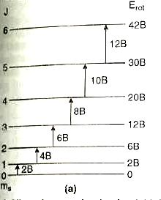
(a)Allowed energy levels of a rigid diatomic rotor showing electric dipole allowed transitions and (b) the resulting absorption spectrum
For a diatomic rigid rotor only transitions in which J changes by one unit that is ΔJ = ± 1 are allowed and all other transitions are forbidden. Thus the selection rule for rotational spectra is ΔJ = ± 1.

Slide 44
VIBRATIONAL (INFRA RED) SPECTROSCOPY
Simple harmonic oscillator (Vibrational motion)
The vibrational motion resembles the motion observed for a ball attached to a spring that is harmonic oscillator which obeys Hook’s law. That is the force, the spring exerts on the particle is a proportional to displacement from the equilibrium position, x(x=0). Hook’s law relates the restoring force, F as F=-fx where f is a force constant. Therefore, the potential energy of the particle will be
V(x)=-Fdx or V(x)= ∫ fx dx
Thus V(x)=1/2 fx²

Slide 45
Application of Newton’s second law gives the familiar equation of simple harmonic motion. The equation of motion according to classical mechanics is
F= md²x / dt²
Hence, restoring force md²x / dt²= -fx

Slide 46
Vibrational motion of a diatomic molecule

Slide 47
Vibrational motion of a diatomic molecule
The displacement coordinates are x₁ and x₂ in Fig. The extension of the spring is (x₂-x₁). The restoring force is then given by
F=-f(x₂-x₁), f is a force constant .......... (1)
The motion can be expressed in terms of Newton's law as follows:
.......... (2)
Similar equations can be written for compression. The solution of these equations (like harmonic oscillator) shows that
.......(3)
where v₀ is the fundamental natural frequency of the system and μ is the reduced mass of the two particle system. Here the fundamental frequency depends on the force constant and the reduced mass of the system.

Slide 48
Vibrational motion of a diatomic molecule
According to the quantum mechanical model, the potential energy is given by
V(x) = l/2f(x2-x1)2 .......(4)
Substituting it in the Schrodinger wave equation we get
.......(5)
where the displacement x=(x2-x1). Thus the vibrational energy of diatomic molecule is
.......(6)
v is called the vibrational quantum number and the frequency v0 is given by equation (3). Converting energy into spectroscopic units, cm-1, we get
.......(7)

Slide 49
Vibrational motion of a diatomic molecule
Different values of vibrational quantum number, v can be derived from equation (7).

Slide 50
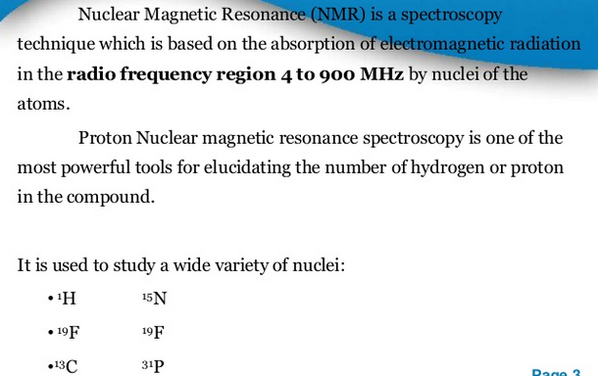
NMR Spectroscopy

Slide 51
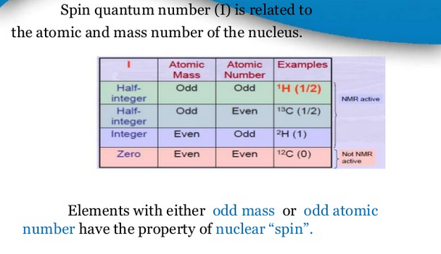
NMR Spectroscopy

Slide 52
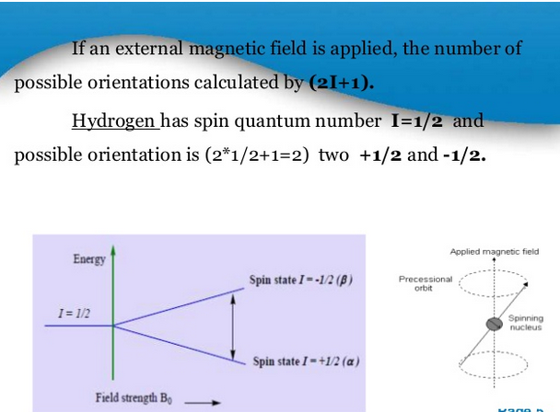

Slide 53
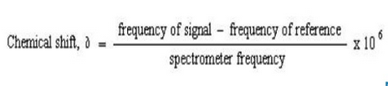
Chemical Shift
A chemical shift is defined as the difference in parts per million (ppm) between resonance frequency of the observed proton and tetramethylsilane (TMS) hydrogens.
TMS is the most common reference compound in NMR, it is set at ∂=0 ppm.

Slide 54
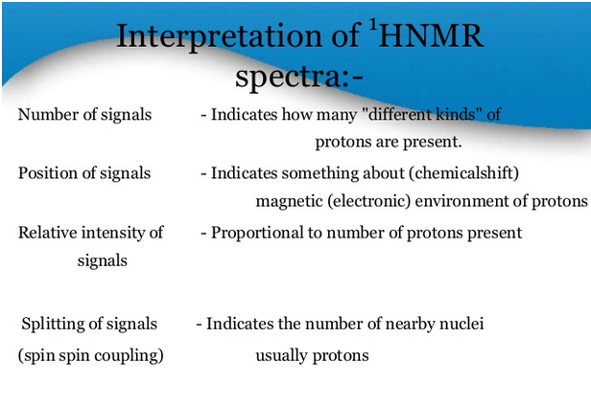

Slide 55
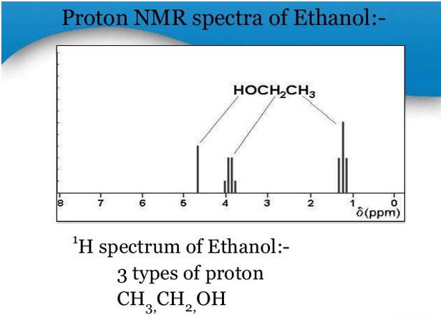

Slide 56
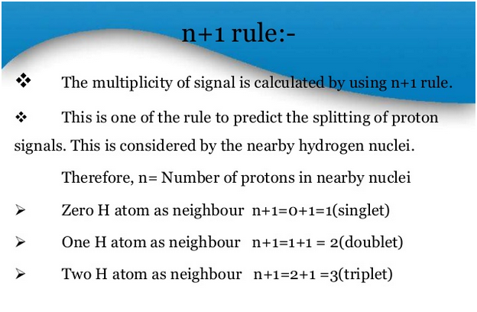

Slide 57
Pascal's Triangle giving Intensities of NMR Signals
Number of Protons, n | Number of NMR lines | Relative Intensities
0 | 1 | 1 1 1 1 2 1 1 3 3 1 1 4 6 4 1 1 5 1 0 1 0 5 1 etc
1 | 2
2 | 3
3 | 4
4 | 5
5 | 6
etc | etc

Slide 58
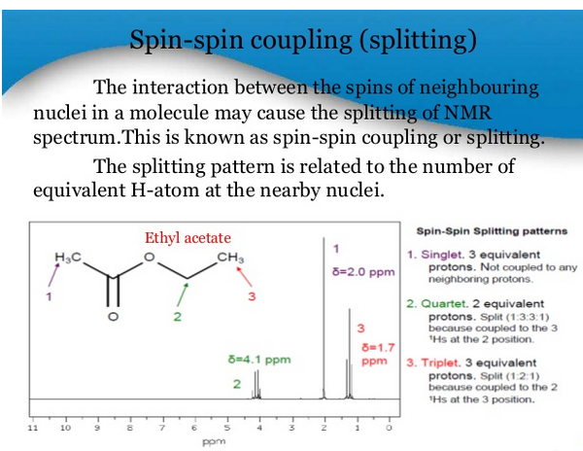

Slide 59
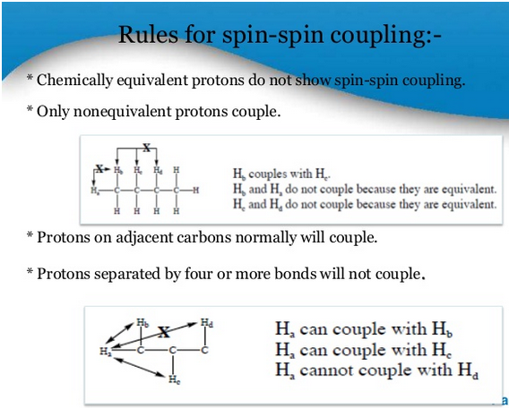

Slide 60
